Slide 1
Quack-as-a-Service
Factory Safety Monitoring System

Slide 2
Problem
Inadequate PPE compliance
Lack of real-time monitoring
Manual safety checks
No emotional state awareness
Fall detection gaps

Slide 3
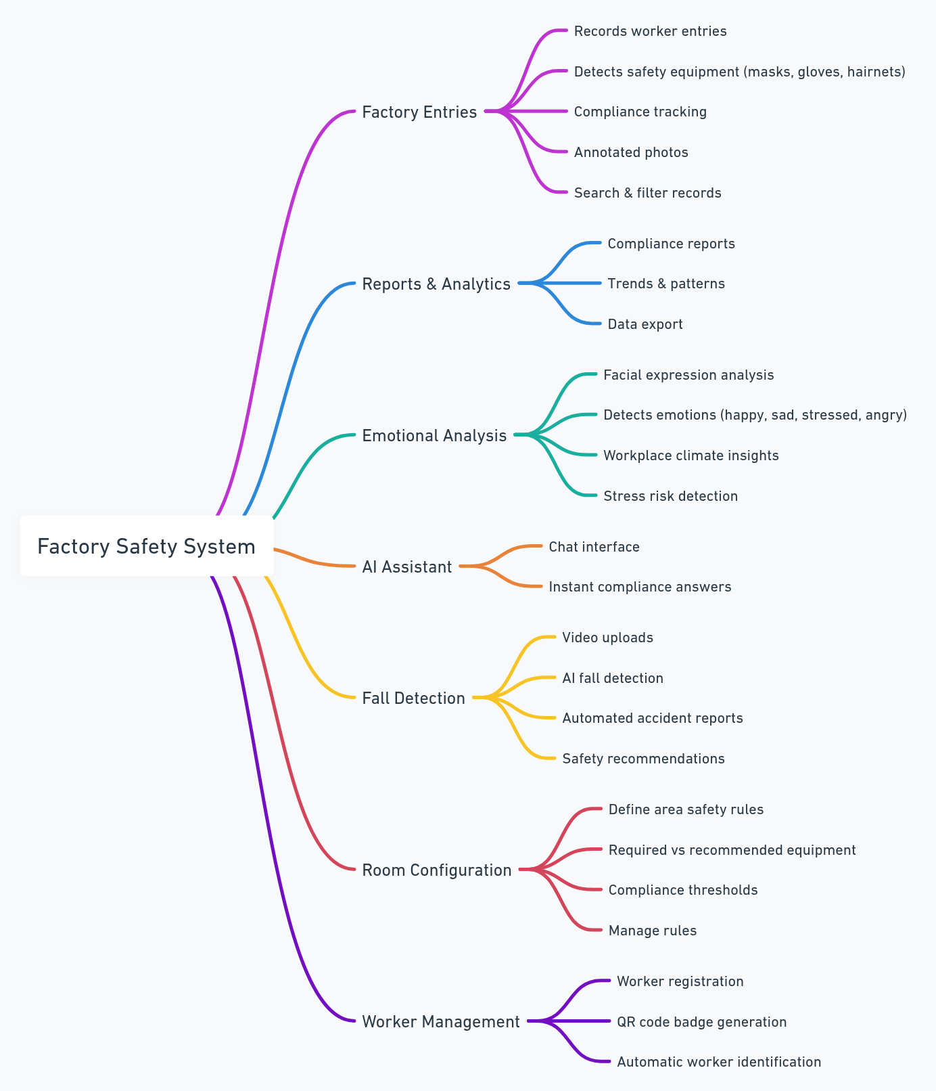
Features

Slide 4
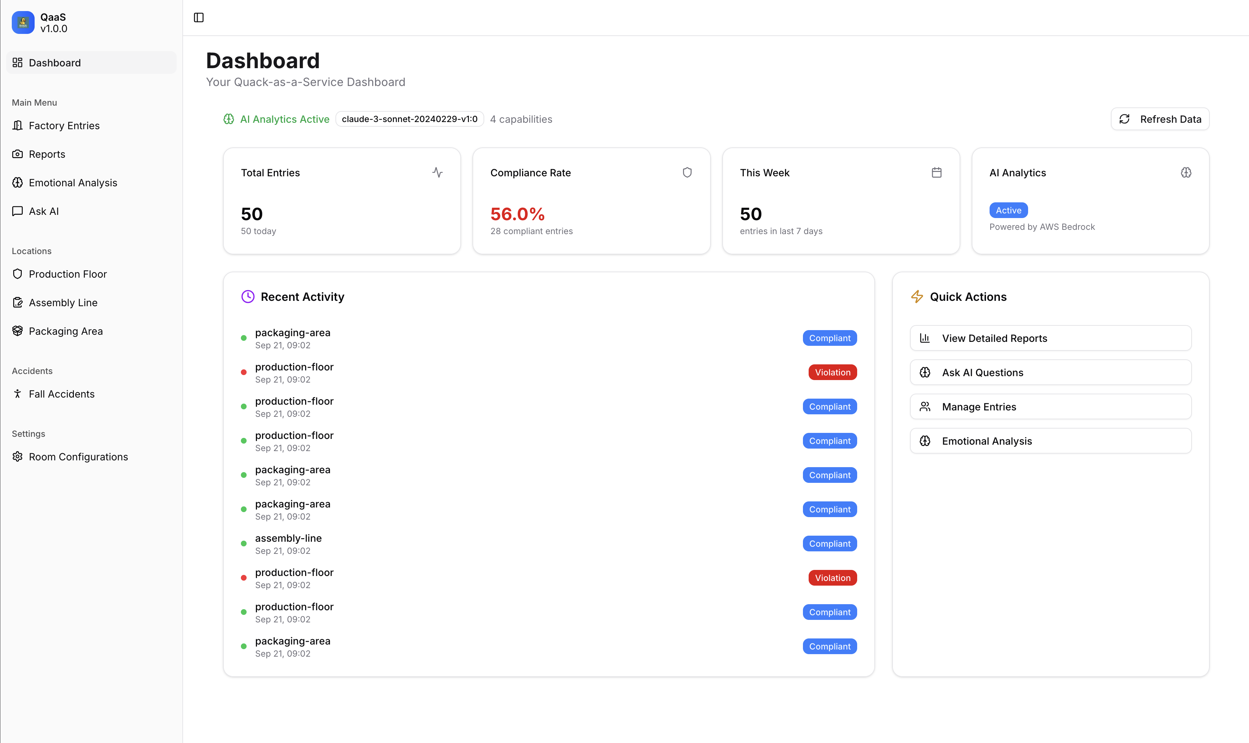

Slide 5
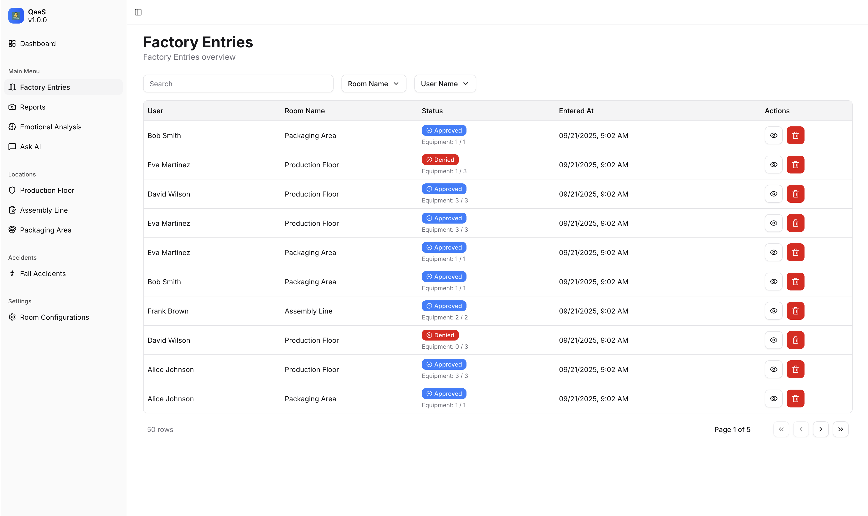

Slide 6
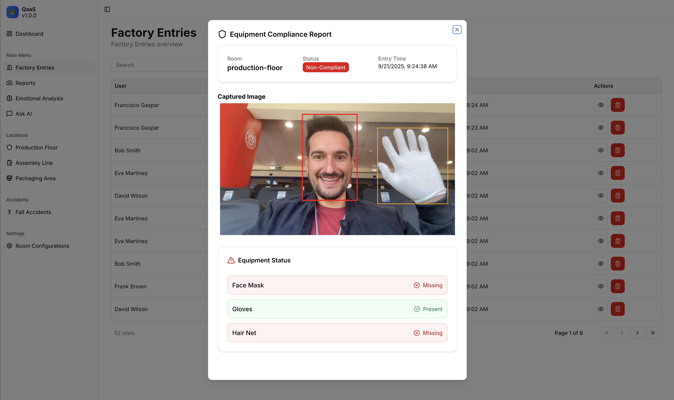

Slide 7
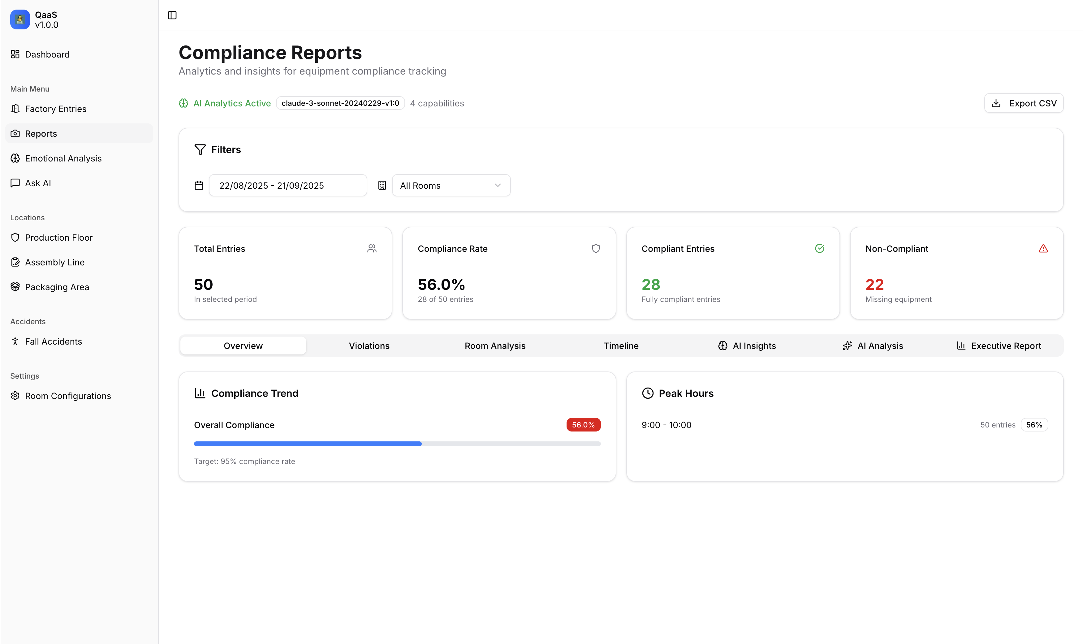

Slide 8
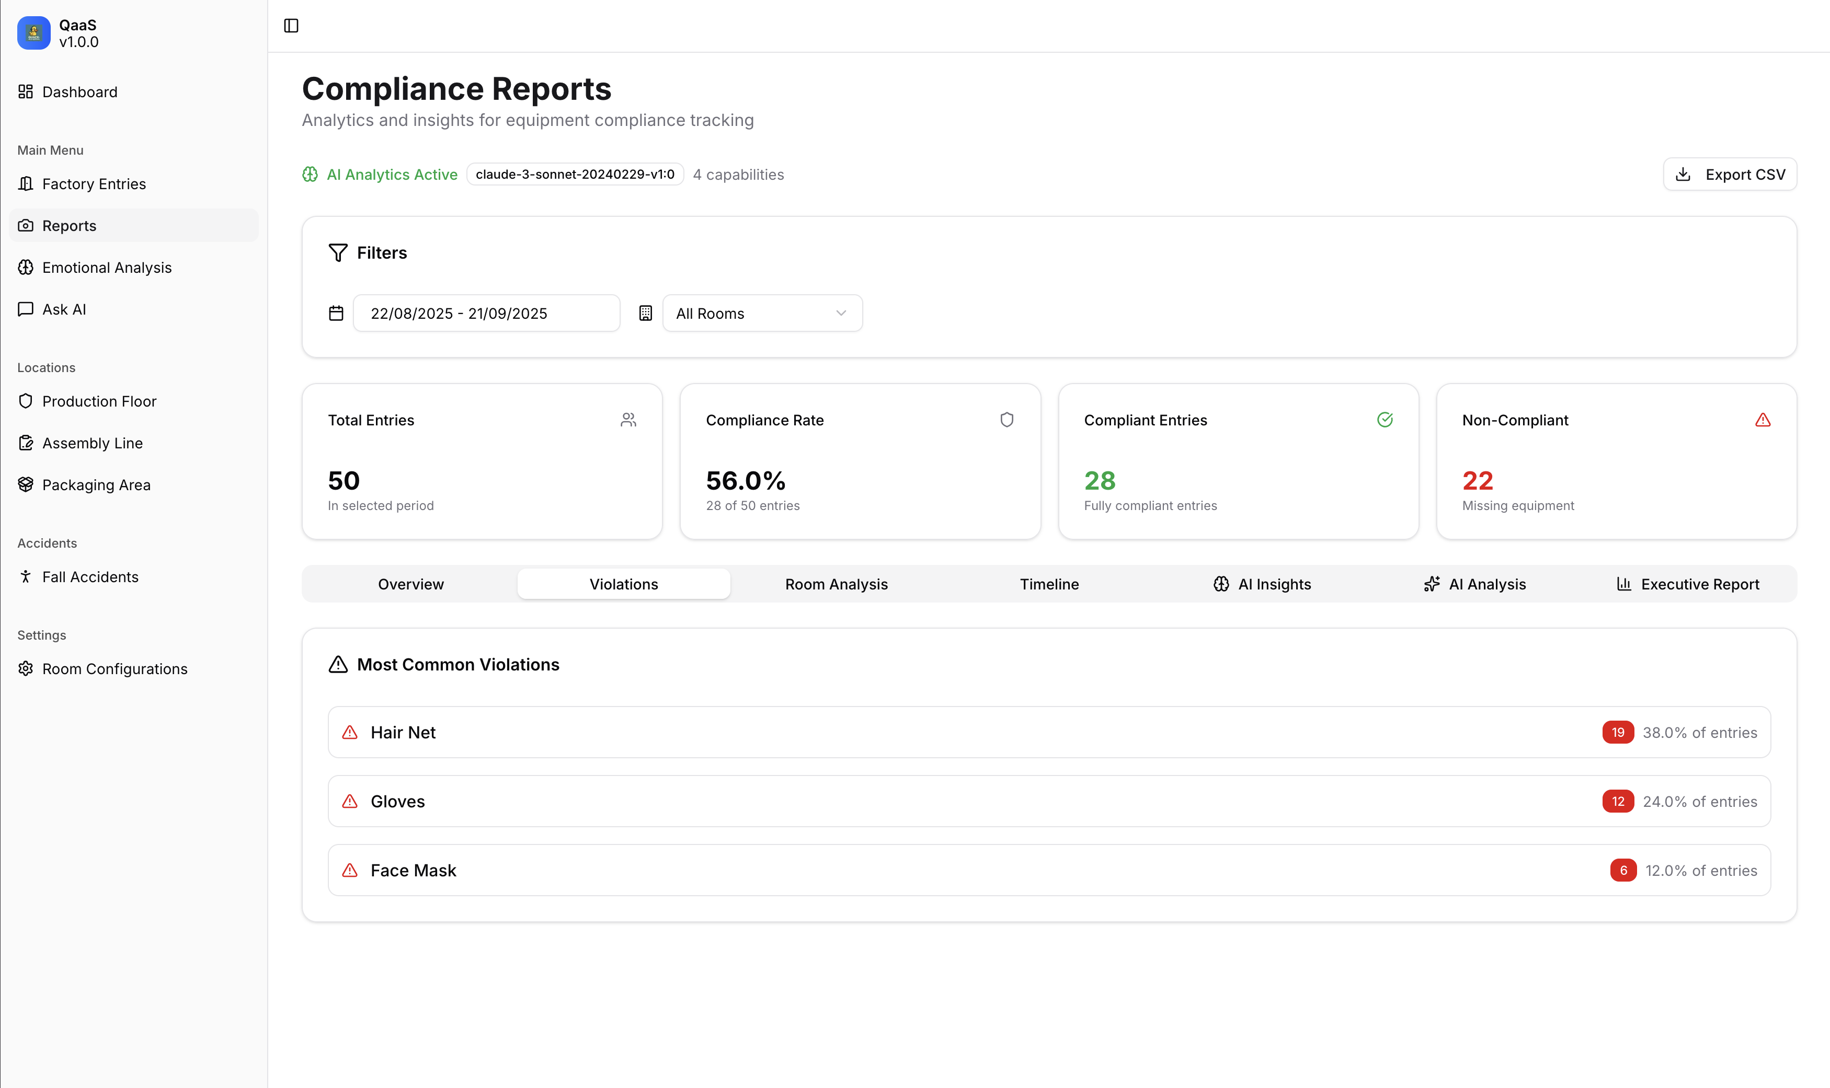

Slide 9
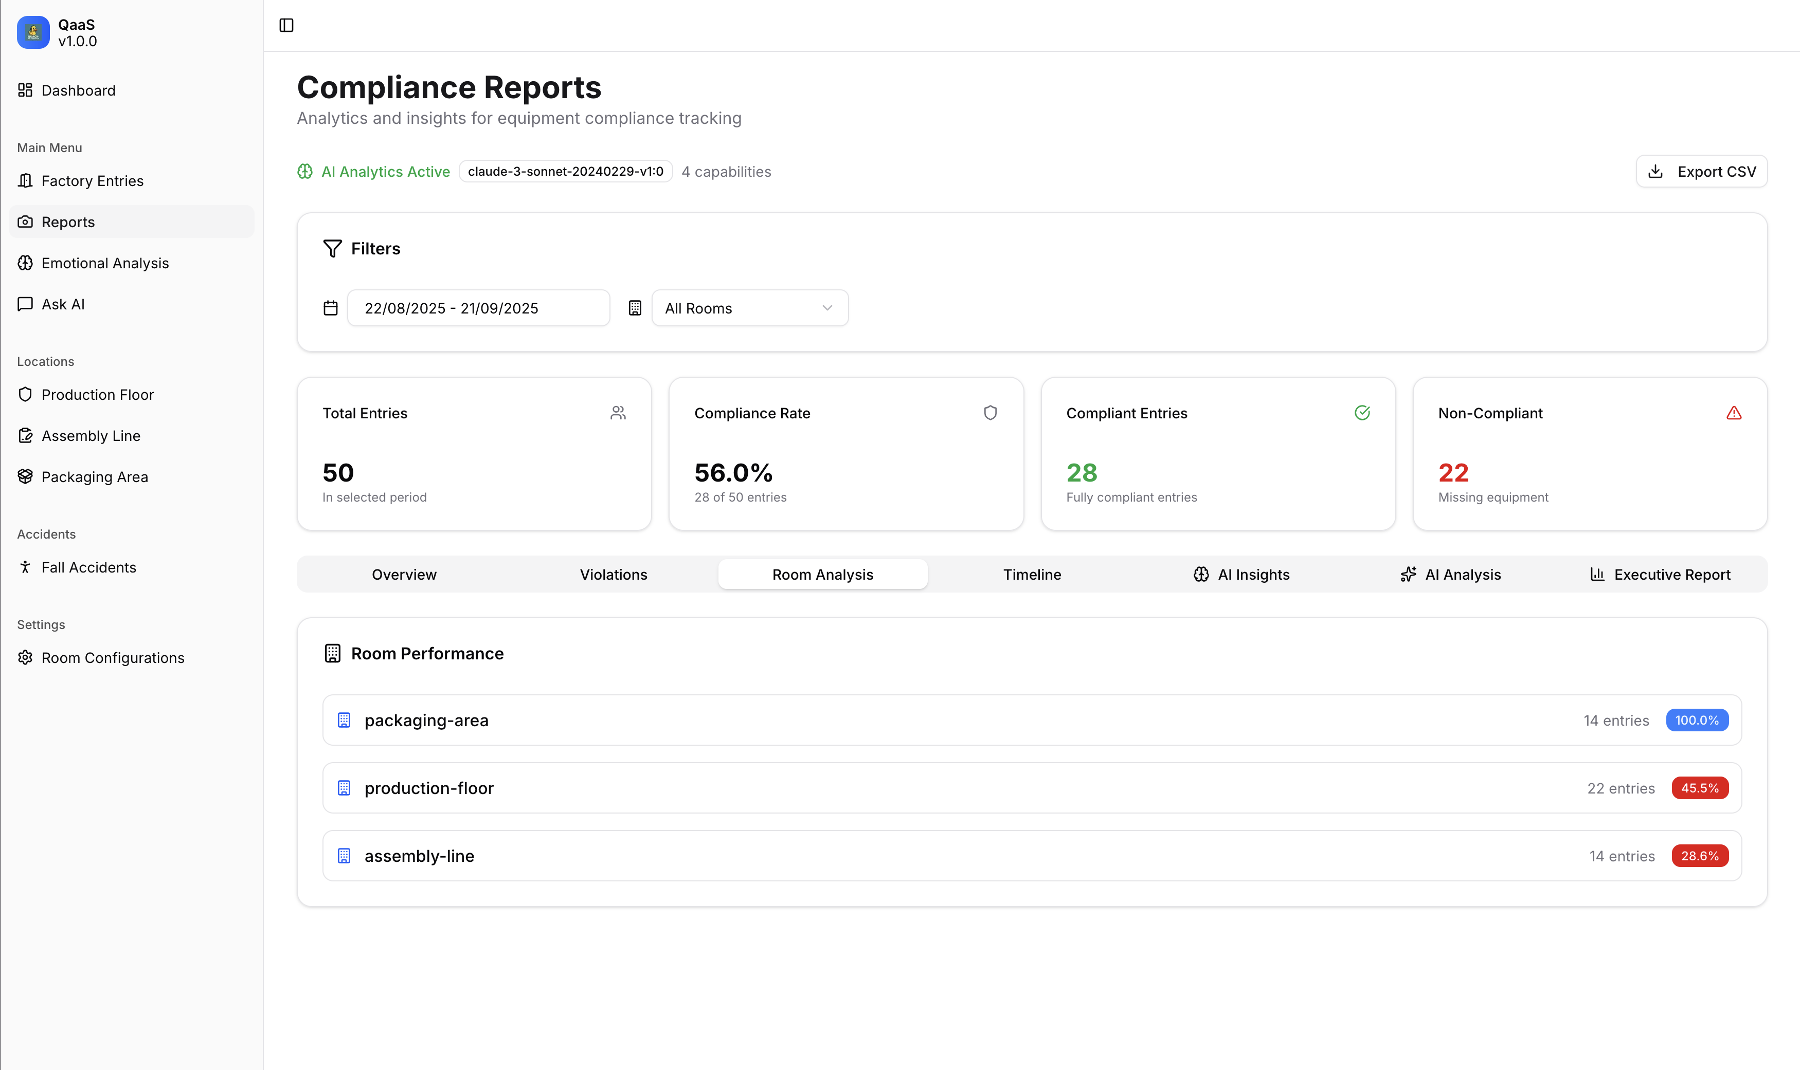

Slide 10
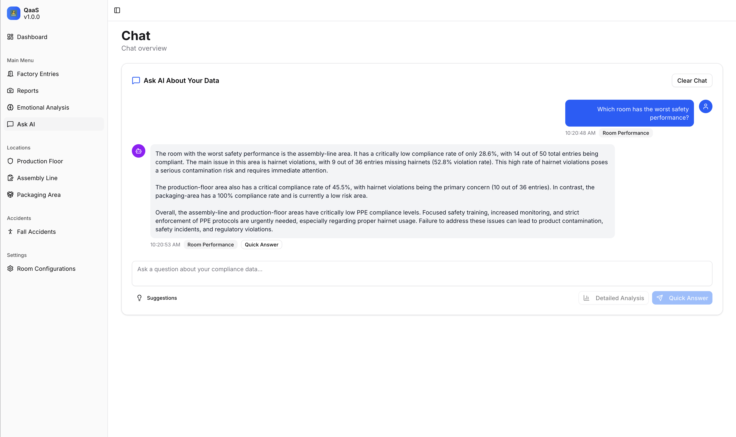

Slide 11
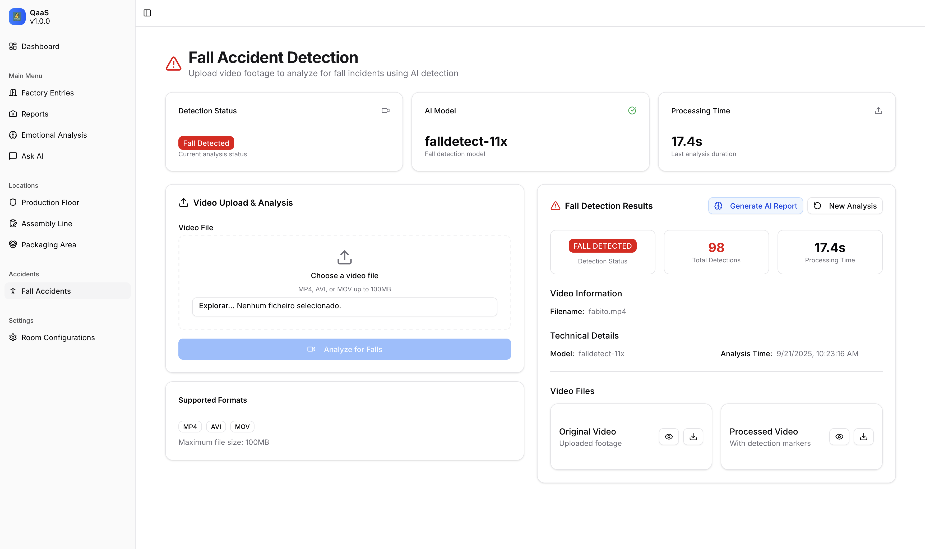

Slide 12
Roadmap
1. Enterprise System Integration Seamless integration with existing HR and access control systems for automatic employee identification 2. Smart Alert & Notification System Proactive notifications to supervisors and safety managers when required safety equipment is missing
Custom notification rules based on room requirements and worker roles
Integration with existing communication platforms (Slack, Teams, etc.)
3. Continuous Real-Time Safety Monitoring
24/7 live monitoring of safety equipment compliance and workplace hazards
Live camera feeds with instant safety equipment detection
Automated incident detection with immediate response protocols
Historical trend analysis and predictive safety insights

Slide 13

Francisco Gaspar Francisco Oliveira Guido Pereira João Ferreira
Factory Safety Monitoring System

